Slide 1
http://www.gallup.com

Slide 2
http://www.gallup.com
Browser contacts DNS (Domain Name System) server that maps web address to IP address

Slide 3
http://www.gallup.com
Browser contacts DNS server that maps web address to IP address
Browser sends web request to server at IP address using TCP/IP

Slide 4
http://www.gallup.com
Browser contacts DNS server that maps web address to IP address
Browser sends web request to server at IP address using TCP/IP
Server processes and responds with HTML, JavaScript, CSS and any other files

Slide 5
Domain Name System
13 “root” DNS authorities made up of hundreds of physical machines that store the addresses
Stored in a hierarchy… if one server doesn’t know it will ask the next one up
Your default server is assigned by your ISP

Slide 6
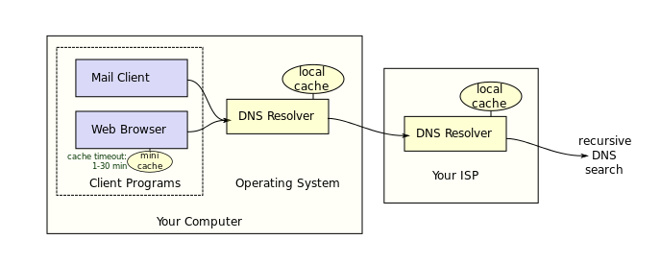
Domain Name System

Slide 7
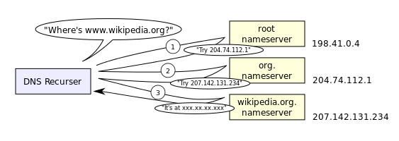
Domain Name System

Slide 8
Domain Name System
ICANN – Internet Corporation for Assigned Names and Numbers
Manages the DNS Root Systems
Tracks registries

Slide 9
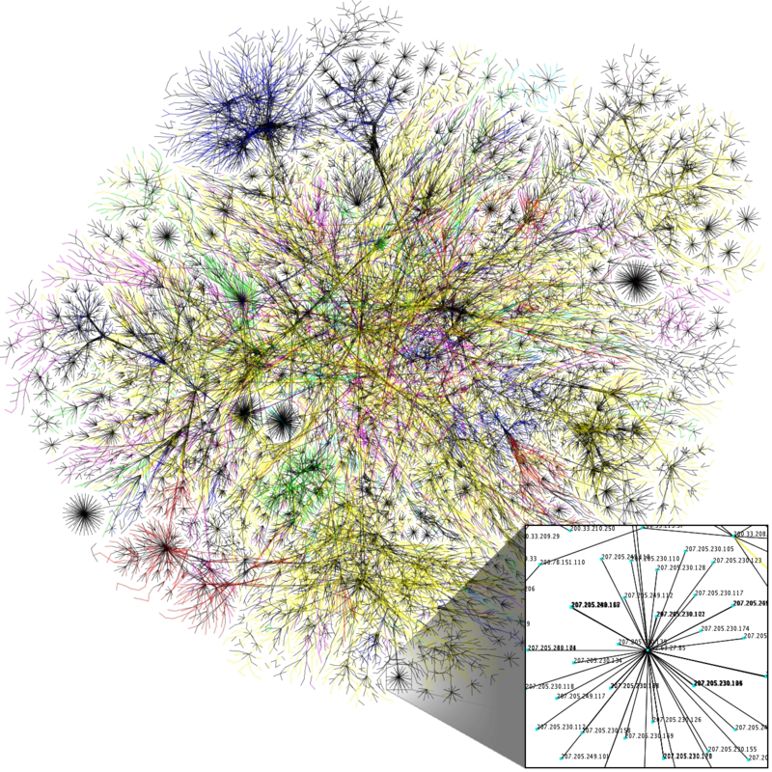

Slide 10
Transmission Control Protocol (TCP/IP)

Slide 11
Transmission Control Protocol (TCP/IP)
Physical Layer – Signals and cables, lower level

Slide 12
Transmission Control Protocol (TCP/IP)
2. Data Link Layer – Transmits packets from node to node, lower level

Slide 13
Transmission Control Protocol (TCP/IP)
3. Network Layer – Routes data based on network layers, lower level

Slide 14
Transmission Control Protocol (TCP/IP)
4. Transport Layer – Ensures delivery of entire message, upper level

Slide 15
Transmission Control Protocol (TCP/IP)
5. Session Layer – Starts and stops web sessions, upper level

Slide 16
Transmission Control Protocol (TCP/IP)
6. Presentation Layer – Encryption and data conversion, upper level

Slide 17
Transmission Control Protocol (TCP/IP)
7. Application Layer – E-mail, client/server, file transfer, upper level

Slide 18
Server
Stores application/web page files and data
Includes utilities to process incoming requests, generate a response and reply to any incoming messages in a timely and scalable manner

